Slide 1

Lending Application Result Predictions October 25, 2019
banknxt.com

Slide 2
APPENDIX
3 | INTRODUCTION
4 | DATA
5 | ANALYTIC APPROACH
6 | BASELINE
7 | SUPERVISED LEARNING RESULTS
8 | XGBOOST – CLOSER LOOK
9 | CONCLUSION

Slide 3
INTRODUCTION
Objective: Using machine learning models to predict whether a loan application will be approved or declined.

Slide 4
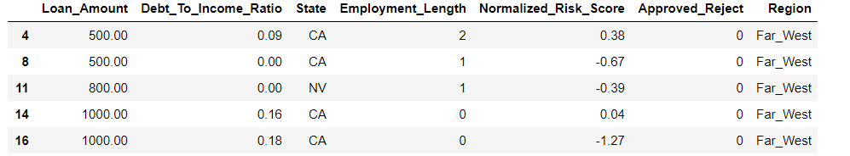
DATA
Lending Club Accepted & Declined Data from 2007 to 2018
Data is sourced from Kaggle website
5% of total data is used due to computation limitation. Stratified random sampling based on Loan_Amount is used for reduction.
Notes:
For the purpose of the exercise, single month of data from March 2018 is used and we are assuming that observations made are applicable to other months of the year. Single month used is due to limitation in computing capacity.
Data includes all geographic areas of the Citi Bike program. Areas include Manhattan, Queens, Brooklyn, and Jersey City. Bronx and Staten Island are not covered by the Citi Bike Program.
Weather data is acquired from Weather.gov based on the Central Park station.
All Citi Bike Program data is acquired from Citibikenyc.com.

Slide 5
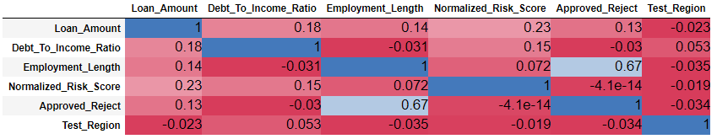
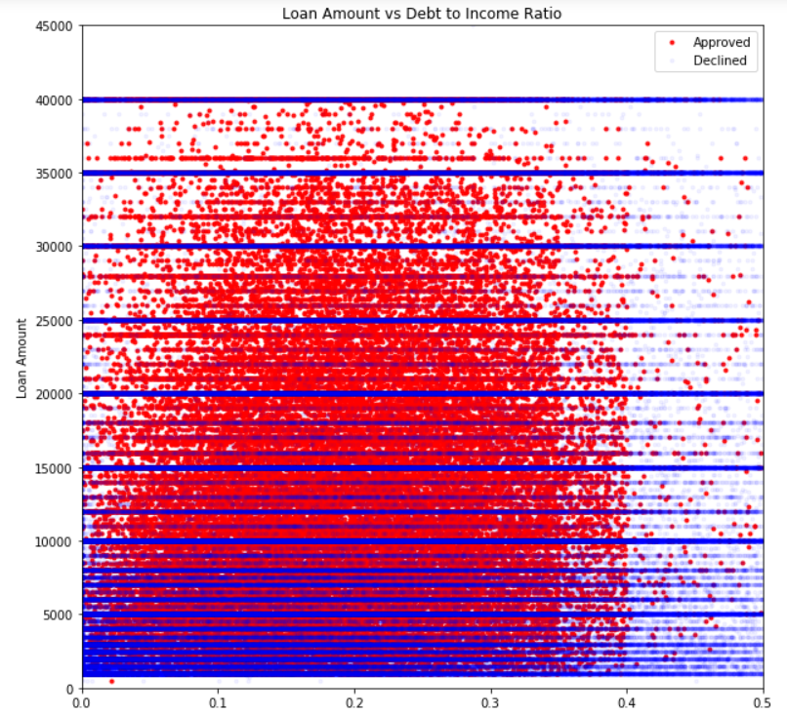
ANALYTIC APPROACH
Initial exploratory data analysis is done to note of any easy to observe patterns in the overall data and to help determine baseline model.
Second part is to apply Classification Supervised Learning to the data.
Models used for this exercise are Logistic Regression, Random Forest, and XGBoost.

Slide 6
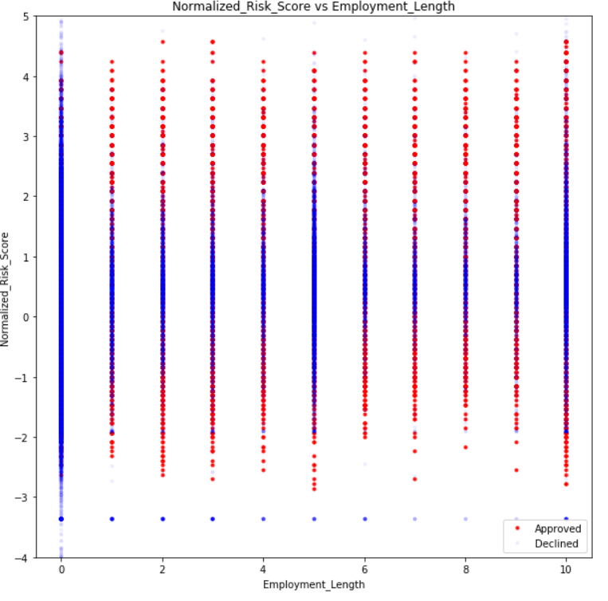
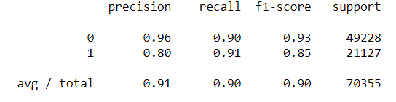

BASELINE
Assumes anything over 40% debt to income ratio or Employment Length < 1year (0 in the graph) to be rejected and anything else to be approved.
Notes:
0 column is predominantly rejected
0.4 DTI is the stated number on Lending Club website
There is a $40k cap for most loans but we have filtered out higher amounts as we treat those as outliers
Correlation table demonstrates that Employment Length is the most important feature
1 is approved
0 is declined

Slide 7
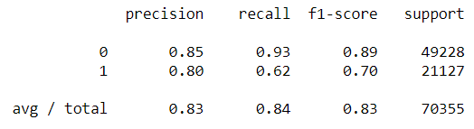
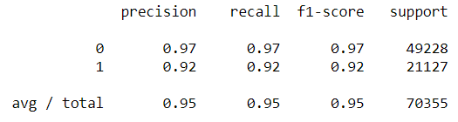
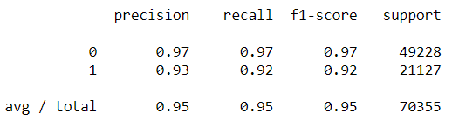






SUPERVISED LEARNING RESULTS
Logistic Regression | Random Forest | XGBoost
XGBoost has the highest AUC Score demonstrating it had the best performance.
Random Forest’s results are very close to that of XGBoost while Logistic Regression actually performed worse than Baseline.

Slide 8
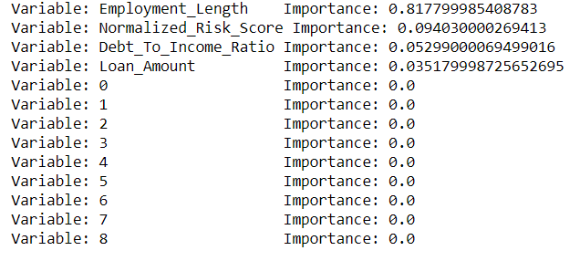
XGBOOST – CLOSER LOOK
Looking at feature importance, Employment_Length has an unusually large influence relative to the other features.
Random Forest has arrived with similar results but a slightly lower importance for Employment _Length.
This result is similar to the correlation table seen previously

Slide 9
CONCLUSION
Results are heavily dependent on Employment Length
Risk Score and Debt to Income ratio also had substantial contribution.
Due to the reliance on Employment Length non-machine learning method is also fairly accurate
However, both Random Forest and XGBoost added significantly more predictive power
With AUC score close to 99%, both RF and XGBoost can be used as a preliminary application model by LendingClub.
Additional areas of expansion would be to get more data for rejection dataset as there are very few features available relative to the approved dataset.

